Slide 1
Global Store Analysis with Tableau by Lakshmi

Slide 2
Objective
To gain insights into Superstore performance, identify key metrics, and support informed decision-making using Tableau.
Creating Interactive Dashboards
Analyzing Profit, Sales, and Product Performance
Visualizing City-Level Performance
Analyze improvements in shipping time

Slide 3
Tableau Dashboards

Slide 4
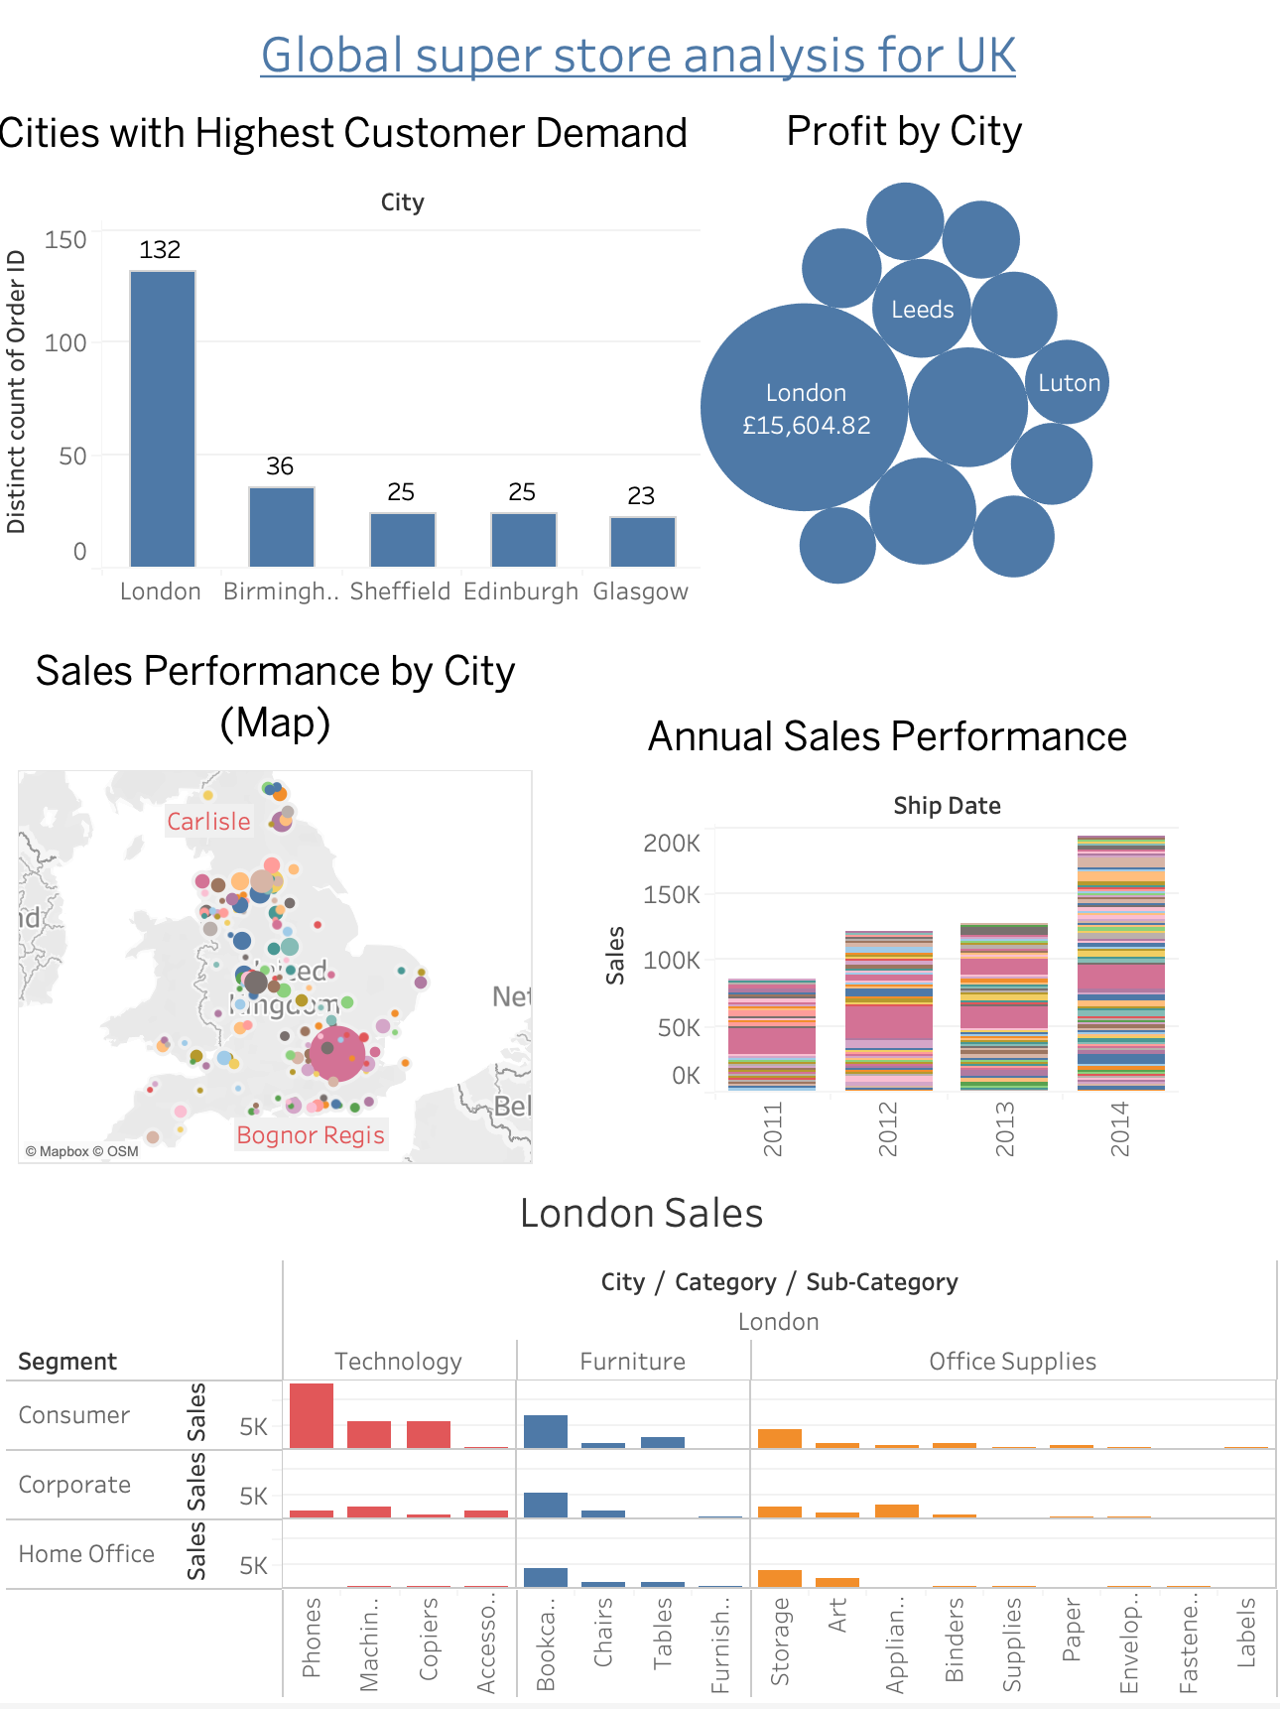
Champion City:
- London is the clear leader in the market, boasting the highest sales, profits, and order volume compared to other cities.
- Key sales in London are driven by phones (consumer segment), bookcases, and storage.

Slide 5
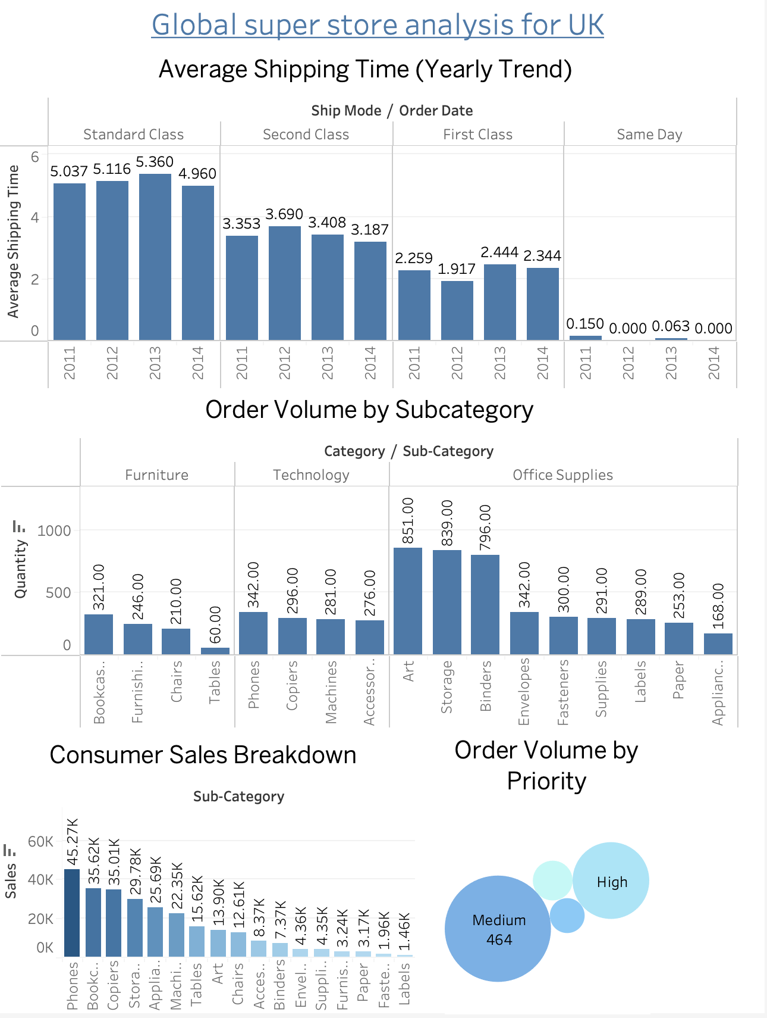
Speed Demons:
- Delivery times have improved across all shipping classes (standard, second class, first class, and same day) by 2014.
- To capitalize on this improvement, promote same-day delivery and offer a free one-month trial to highlight the convenience.
The Priority Game:
- Orders categorized as medium priority dominate, followed by high, critical, and low priorities.
- This indicates a balanced mix of urgent and routine deliveries.

Slide 6
Artful Orders:
- Art supplies, storage solutions, and binders are popular, particularly in office environments.
- Items like pencils, highlighters, sharpeners, and watercolors are selling well, suggesting a trend toward artistic expression or increased organizational needs.
- To boost sales, consider offering discounts on office supplies such as paper, envelopes, labels, and furnishings.

Slide 7
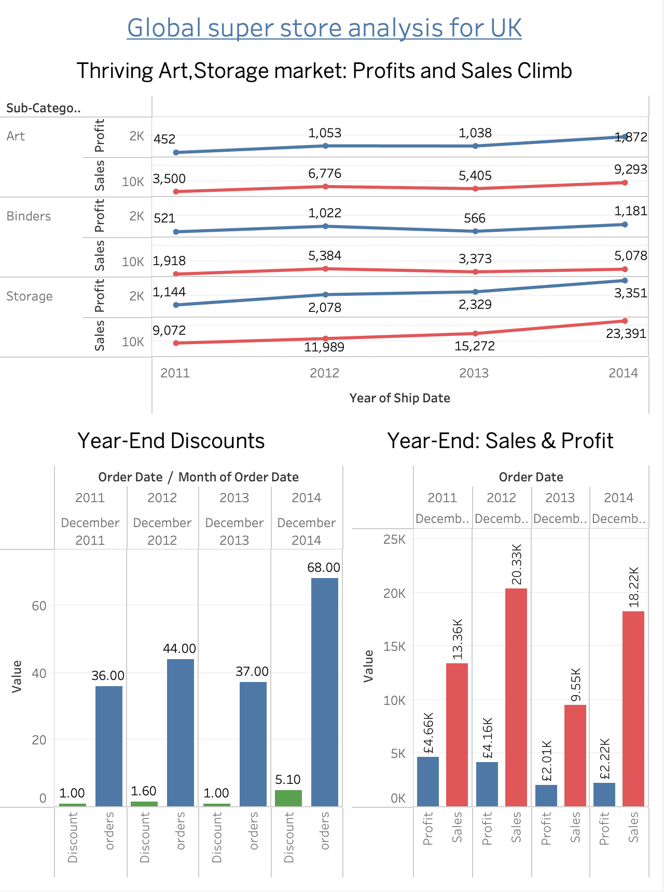
Sales Momentum:
- Annual sales have shown an impressive upward trajectory from 2011 to 2014, with only a minor dip in growth between 2012 and 2013.
- This growth is driven by strong performances in subcategories like bookcases, copiers, and phones, alongside continued demand for storage solutions and appliances.
December Domination:
- While 2014 overall showed growth, December 2012 recorded the highest sales and profits in a single month.
- A strategic marketing campaign around the holidays could potentially rekindle this success.
- Although increased discounts in December 2014 led to more orders, sales in 2012 were higher, indicating the need for further analysis of this discrepancy.

Slide 8
Final tips & takeaways
This Global Super Store dashboard for the UK provides a positive outlook, indicating projected growth in sales, profits, and orders for the upcoming years. Specifically, the London region and consumer phone orders, as well as art supplies, show significant potential.
Few suggestions to improve outcomes-
Promote same-day delivery and offer a free one-month trial to highlight the convenience.
A strategic marketing campaign around the holidays could potentially rekindle this success.
To boost sales, consider offering discounts on office supplies such as paper, envelopes, labels, and furnishings.

Slide 9
Thank you

